Slide 1
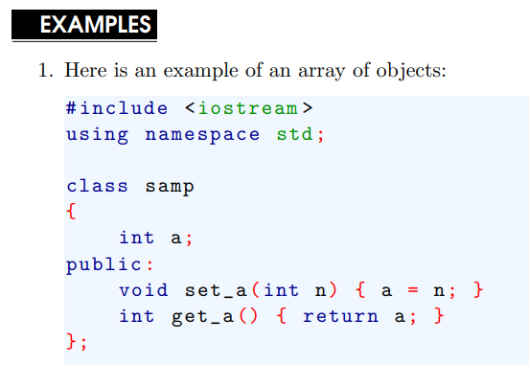
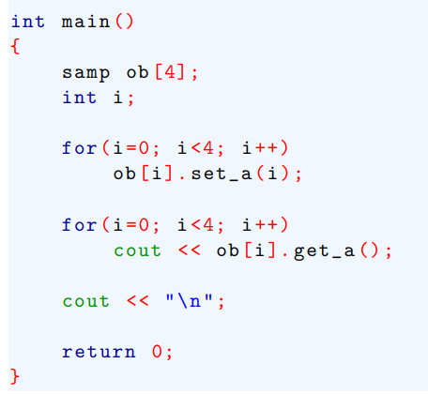
Array, Pointers, and References
Arrays of Objects
Objects are variables and have the same capabilities and attributes as any other type of variable.

Slide 2
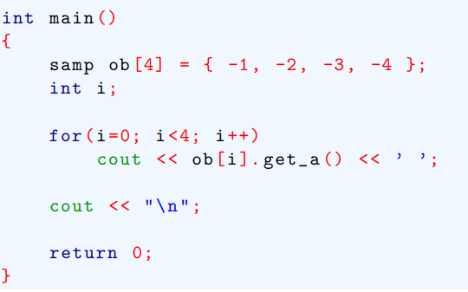
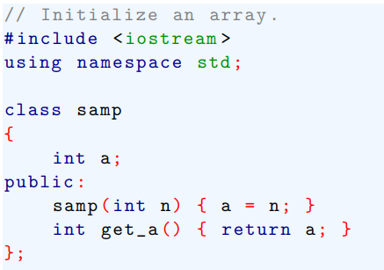
Array, Pointers, and References
Arrays of Objects
If a class type includes a constructor, an array of objects can be initialized. For example, here ob is an initialized array.

Slide 3

Array, Pointers, and References
Arrays of Objects
Actually, the syntax shown in the initialization list is shorthand for this longer form

Slide 4
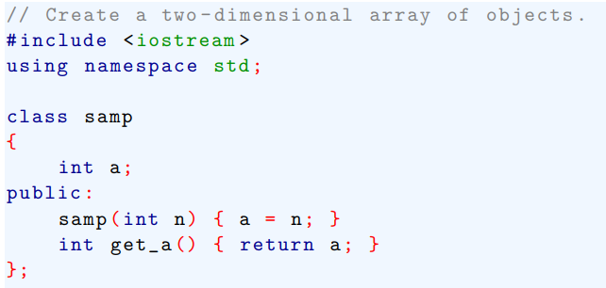
Array, Pointers, and References
Arrays of Objects
We can also have multidimensional arrays of objects.

Slide 5
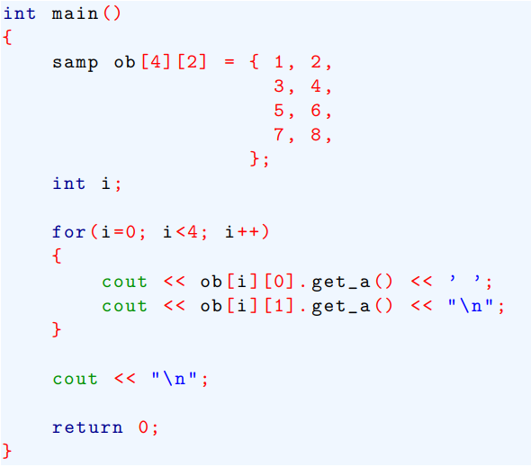
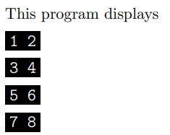
Array, Pointers, and References
Arrays of Objects

Slide 6
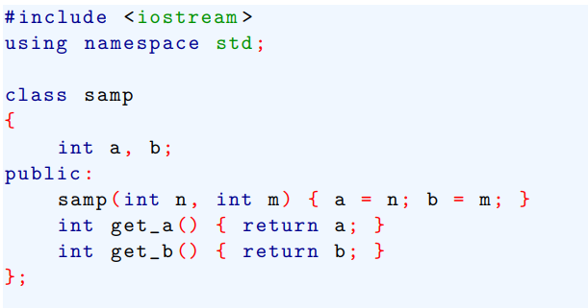
Array, Pointers, and References
Arrays of Objects
A constructor can take more than one argument.

Slide 7
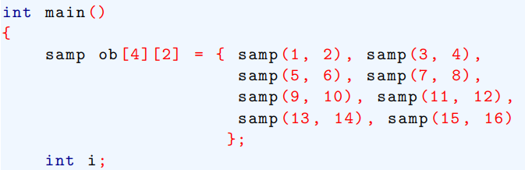
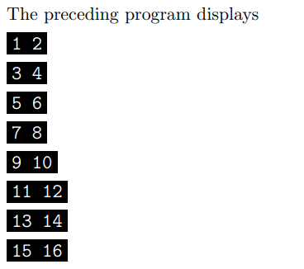
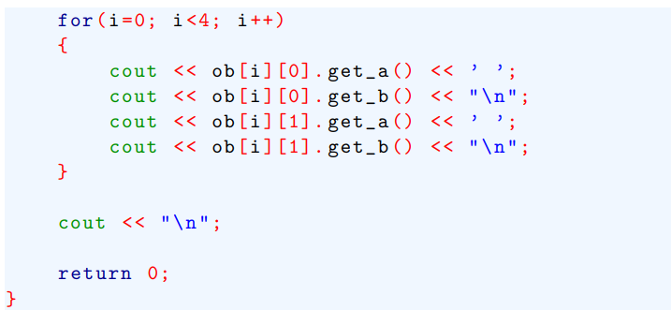
Array, Pointers, and References
Arrays of Objects

Slide 8
Array, Pointers, and References
Using Pointers to Objects
Pointer arithmetic using an object pointer is the same as it is for any other type:
For example, when an object pointer is incremented, it points to the next object. When an object pointer is decremented, it points to the previous object.

Slide 9
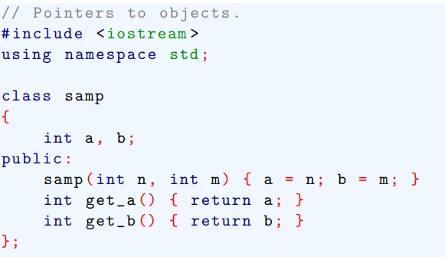
Array, Pointers, and References
Using Pointers to Objects

Slide 10
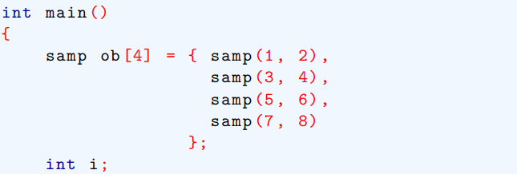
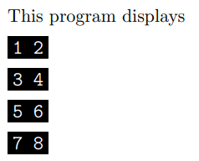
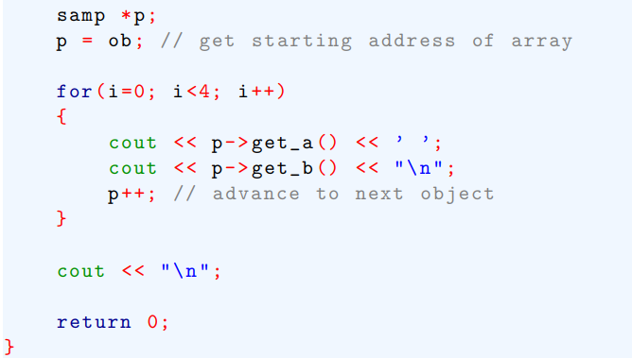
Array, Pointers, and References
Using Pointers to Objects

Slide 11
Array, Pointers, and References
The this pointer
C++ contains a special pointer that is called this.
this is a pointer that is automatically passed to any member function when it is called, and it is a pointer to the object that generates the call.
For example, given the statement
ob.f1( );
The function f1 ( ) is automatically passed a pointer to ob which is the object that invokes the call.
This pointer is referred to as this.

Slide 12
Array, Pointers, and References
The this pointer
It is important to understand that any member functions are passed a this pointer.
For example, a friend does not have a this pointer.

Slide 13
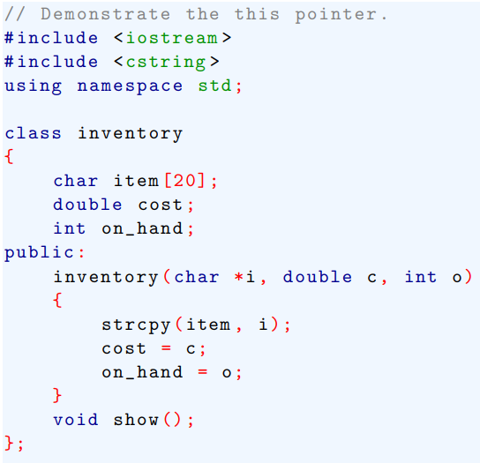
Array, Pointers, and References
The this pointer : Example

Slide 14
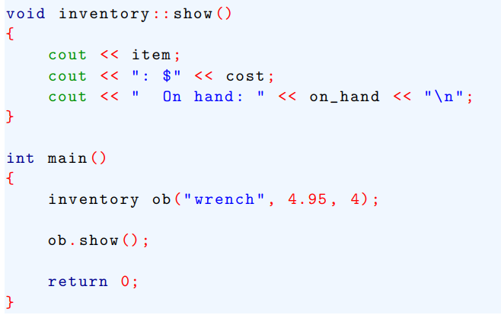
Array, Pointers, and References
The this pointer : Example

Slide 15
Array, Pointers, and References
The this pointer : Example
When a member function is called, it is automatically passed a this pointer to the object that invoked the call.
Thus preceding program could be rewritten as shown here.

Slide 16
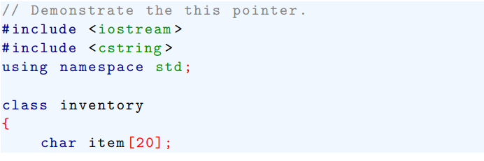
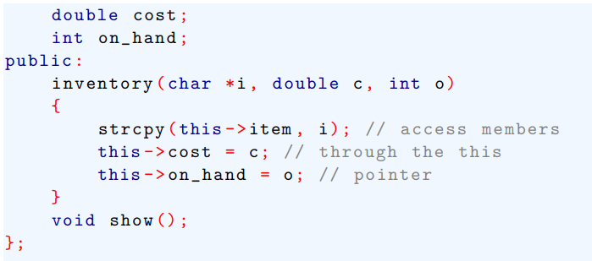
Array, Pointers, and References
The this pointer : Example

Slide 17
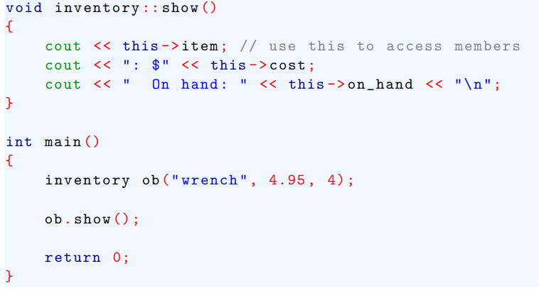
Array, Pointers, and References
The this pointer : Example

Slide 18

Array, Pointers, and References
The this pointer : Example
Here the member variables are accessed explicitly through the this pointer.
Thus, within the show ( ), these two statements are equivalent:

Slide 19

Array, Pointers, and References
Using new and delete
The standard C dynamic allocation functions using malloc ( ) and free ( )
In C++, you can allocate memory using new and release it using delete. These operators takes these general forms:

